Slide 1
CSE/MB620 · DEEP LEARNING WITH PYTORCH · COURSE PROJECT
Ask the model to write a digit
Digits on Demand: a class-conditional diffusion model, built and trained from scratch on MNIST — small on purpose, demonstrated live.
Aleh Haiko · October 24, 2026
sample(label=3) → 3
Notes:
Hook: same mechanism as image generators, small enough for one notebook; live run at the end.

Slide 2
One model, one narrow job
The task
Why small
The data
Generate handwritten digits on request: ask for a 3, get a 3. Diffusion — the course’s 20-point model — plus class conditioning.
A narrow-domain model trained end to end beats a grand plan that does not run. Under a quarter-million parameters, trains on a free Colab GPU in six minutes.
MNIST: 60,000 labeled digits, 28 × 28 grayscale. Labels come free: they become the condition, not a classification target.
Downloaded vs built
Downloaded: the dataset and a reference repo for comparison (TeaPearce/Conditional_Diffusion_MNIST). Built: AI-assisted code — read, verified, and edited by me; every design decision is mine to defend.
Notes:
Problem = controllable generation, not MNIST. Downloaded vs built is mandatory.

Slide 3
How it works
3
3·
···
noise
Add Gaussian noise for T = 400 steps by a fixed schedule. No training here, the data labels itself.
Forward
noise
denoiser
predicts noise
3
The network’s only job: estimate the noise at step t. Subtract it step by step, no closed form, so sampling iterates.
Reverse
The digit label rides along as an embedding, injected into every denoising step. It’s the same move that lets Stable Diffusion follow a text prompt, at 1/1000 the size. Trained with MSE on predicted vs real noise, timesteps drawn at random.
Condition
Notes:
One line only; the professor knows the mechanism. Point at the Condition row.

Slide 4
What is built on top of the baseline
1 · Own denoiser
2 · Class conditioning
A compact U-Net written from the course material—downsampling, bottleneck, horizontal skip connections—instead of the repo’s architecture. 228,897 parameters.
nn.Embedding(10, d) for the digit label plus a sinusoidal timestep embedding, both injected into every U-Net stage.
3 · Guidance knob
4 · Measured, not estimated
Classifier-free guidance: labels are dropped 10% of the time in training, and one slider at sampling trades variety for legibility (shown live).
Every number on the results slide comes from the real run committed to the repo: training time, loss endpoints, sampling speed. No borrowed figures.
Notes:
Grade slide — slowest pace. From the repo: only a comparison baseline, none of its code.

Slide 5
Training: one line of loss
t = randint(0, T, (batch,))
x_t, noise = forward(x0, t)
loss = mse(model(x_t, t, label), noise)
loss, measured
1.105 → 0.040
Random timestep per image: the model sees every corruption level
The label is an input: no annotation beyond what MNIST ships
Adam, lr 1e-3, batch 256, 30 epochs on a free Colab T4
30 epochs · 348 seconds · T4
The start is no accident: predicting unit Gaussian noise blindly costs exactly 1.0 of MSE.
Notes:
Q prep: closed-form forward jump via alpha-bar; no closed form for the reverse — hence iterative sampling.

Slide 6
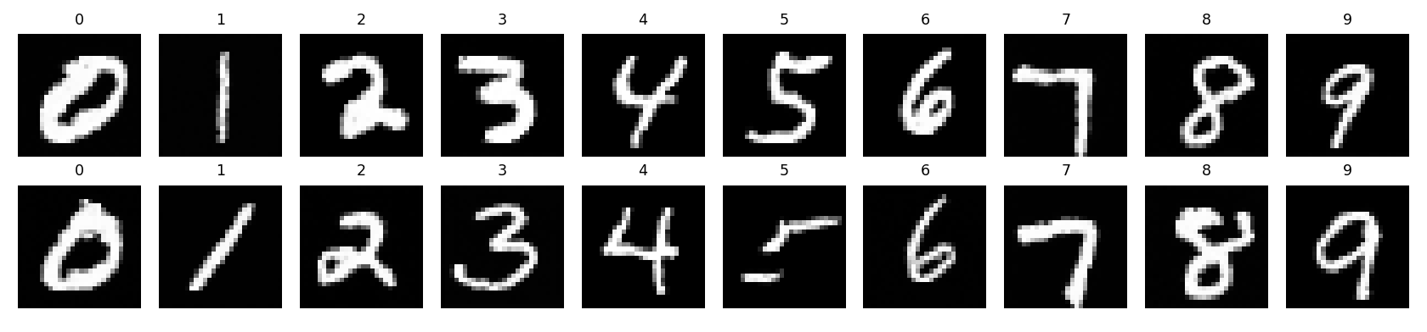
Results
10 / 10
Requested classes render legibly in the committed sample grid
5 s
To sample a batch of ten digits on the demo GPU
0.23M
Every column is a requested class: the model draws what you ask.
Parameters — thousands of times smaller than Stable Diffusion’s denoiser
Notes:
All numbers measured: 30 epochs, 348 s, loss 1.105 to 0.040. Grid = samples_mnist.png from the repo.

Slide 7
LIVE DEMO
Pick a digit.
Watch it appear from noise.
clone the repo
sample(label=?)
guidance 0 vs 4
Code + trained checkpoint, public on GitHub
The audience picks the digit · ~5 s
Variety vs legibility, same seed
Fallback: the checkpoint is committed, so a fresh clone restores the demo in about a minute; offline, the same script samples on CPU.
Notes:
The ask-the-audience moment is the presentation. Narrate the 400 network calls during the 5-second sample.

Slide 8
Takeaways
What worked
Measured results
Next step
The whole diffusion recipe fits in one notebook: fixed forward process, noise-predicting U-Net, iterative sampling. Conditioning is one embedding away.
Loss 1.105 → 0.040 in 348 seconds.
All ten classes render on request.
228,897 parameters end to end.
Swap the U-Net denoiser for a small transformer—the DiT move from class—and compare at equal parameter count.
Code, checkpoint and samples: github.com/AlehHaiko/digits-on-demand
Thank you
Notes:
End under 7 minutes. Q&A answers in the script.

